Slide 1


Clean Water Workshop
Notes:
*Presenter 1*
Say hi!
Introduce the team
Outline:
Presenter 1: Intro
Presenter 2: EWB and Engineering
Presenter 1: Water
Presenter 2: Reality in Developing World
Presenter 1: Appropriate Technology
Presenter 2: Instructions
Presenter 1: Debrief
Presenter 2: Turbidity
Presenter 1: Quiz and University pathways

Slide 2
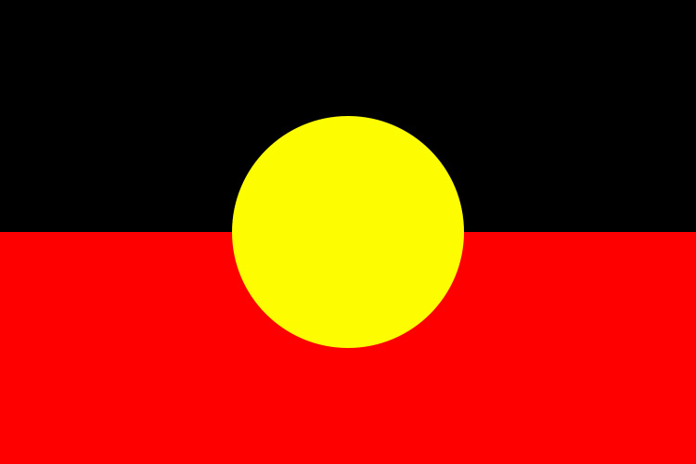


Acknowledgement of Country
We would like to acknowledge and pay our respects to the Traditional Owners of this country, and the custodianship of their elders past, present and into the future.
Notes:
*Presenter 1*
Acknowledgement of country. *read off slide*

Slide 3
Timeline
Appropriate technology
Activity of the Day!
What are engineers?
Pop quiz and questions
Who are EWB?
Notes:
*Presenter 1*
Give them a run down of what the workshop will be like. Don’t spend more than about 1-2 minutes on this slide.
Really important to run this slide so the kids have an idea of what they’re going to be doing for the workshop session! They will stay more engaged this way

Slide 4
Objectives
Work in a team to manage limitations and create a solution
Understand appropriate technology and sustainable development
Describe in your own words what it is to be engineer
Have Fun!
Notes:
*Presenter 1*
Skim over these learning outcomes, no need for an in-depth explanation

Slide 5
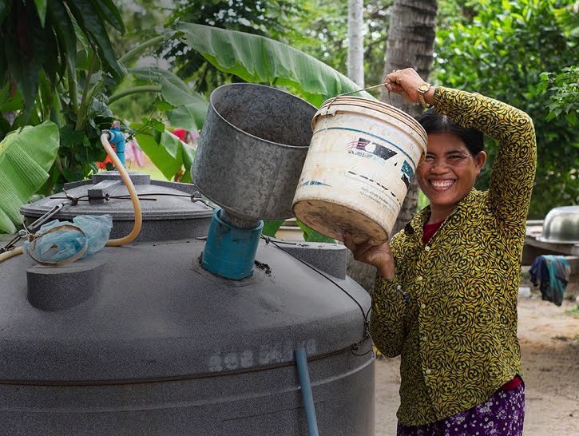
Who are EWB?
We connect, educate and empower people through humanitarian engineering
Notes:
*Presenter 2*
Engineers Without Borders Australia (EWB) is a member-based, community organisation that creates social change through engineering
EWB works in partnership with developing communities in Australia and overseas, helping them to gain the knowledge, resources and appropriate technologies that they need to give them more control of their lives.

Slide 6
What are Engineers?
Notes:
*Presenter 2*
First of all, what exactly is an engineer?
Does anyone have a relative or friend who is an engineer?
[If any students put up their hands, then:] What does your father/mother/uncle do at work?
[Skip if time constrained]

Slide 7
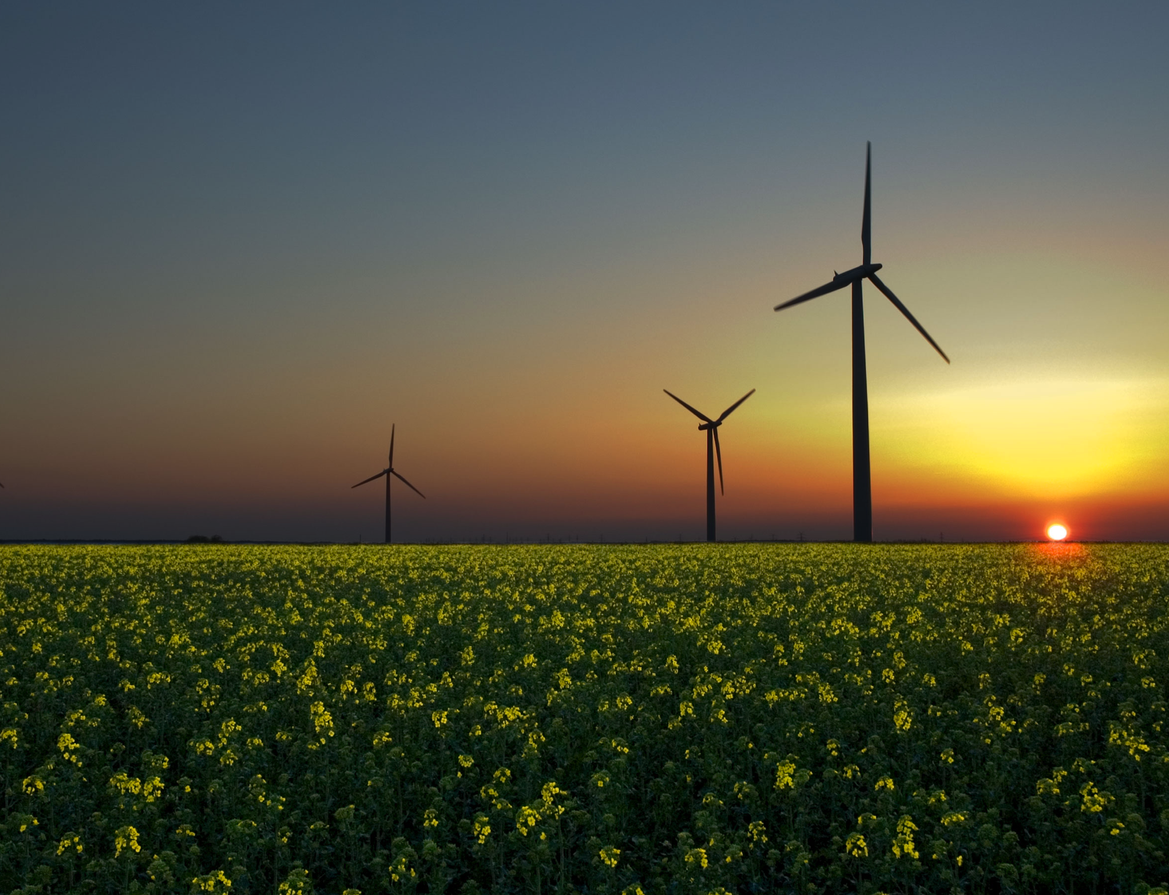
What are Engineers?
Engineers respond to needs of society by providing technological solutions to everyday problems in order to improve the quality of life
Notes:
*Presenter 2*
*Presenter 2*
First of all, what exactly is an engineer?
Does anyone have a relative or friend who is an engineer?
[If any students put up their hands, then:] What does your father/mother/uncle do at work?
[Skip if time constrained]

Slide 8
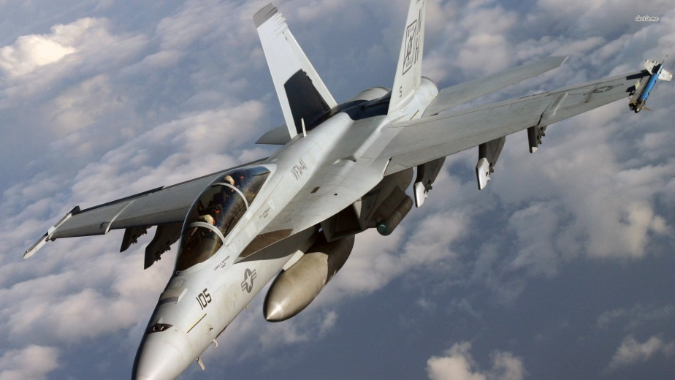
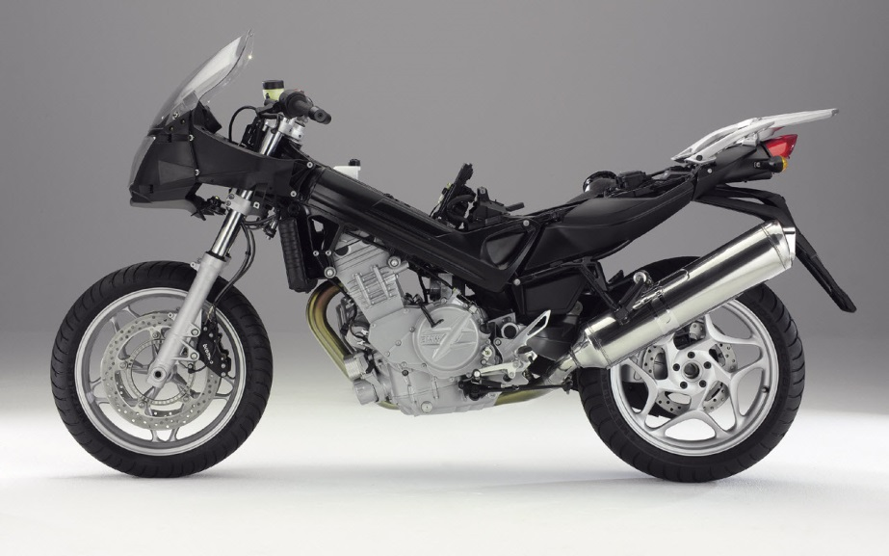
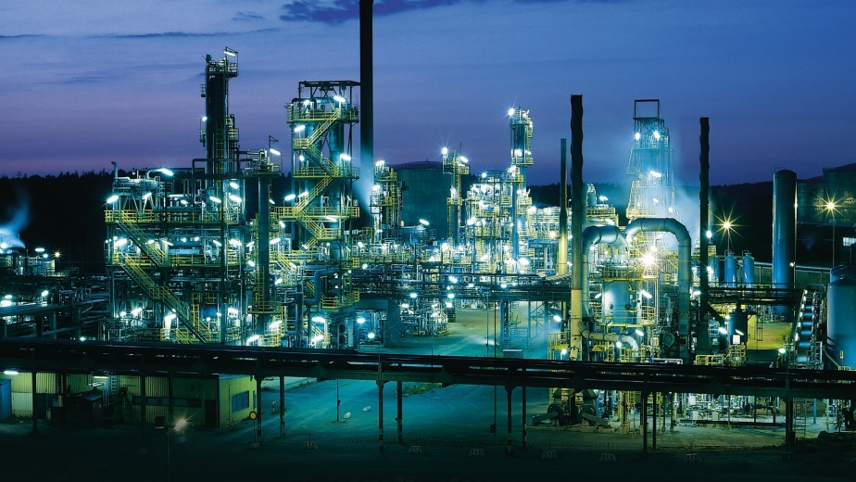


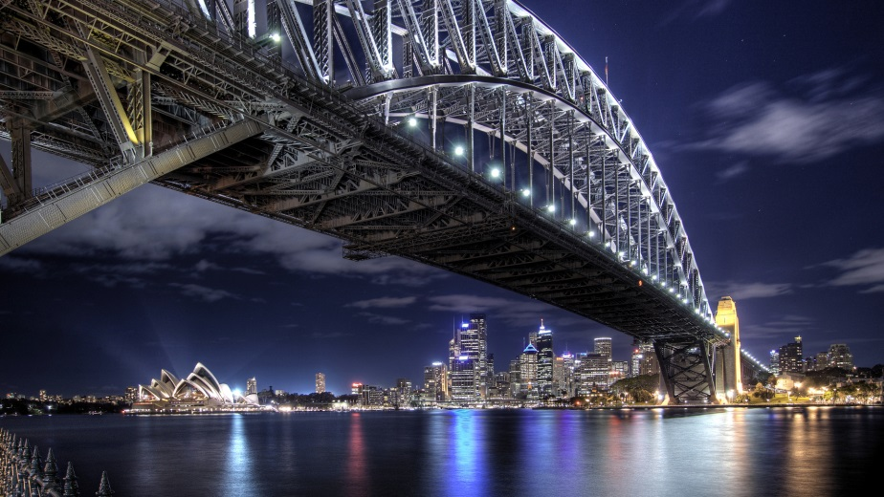
Types of Engineers
Aerospace
Mechanical
Chemical
Electrical
Mechatronic
Civil
Notes:
*Presenter 2*
Mechanical engineers design and analyse moving systems found in things like cars and machines.
Aerospace engineers uses similar principles to look at how we can make machines that fly. Like planes and rockets!
Electrical engineers work on everything from power supply to computers, phones and everything in between. Anything that involves electronic circuits usually has an electrical engineer behind it.
Mechatronics engineers combine skills from mechanical and electrical engineers to design robots.
Civil engineers design and build all the structures that we use today: like bridges, buildings and dams.
Chemical engineers use a knowledge of chemistry and processes to make useful things like fuel, medicine and food, out of materials found in nature, like rocks and plants.

Slide 9
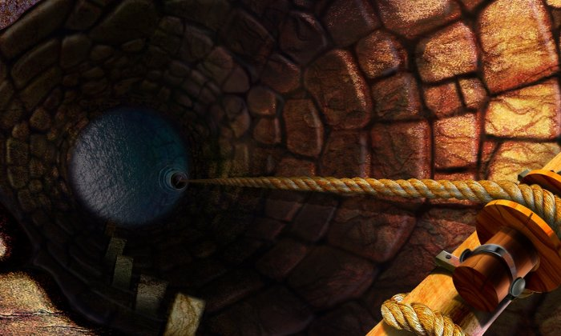
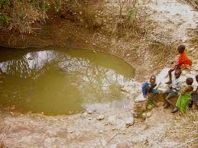
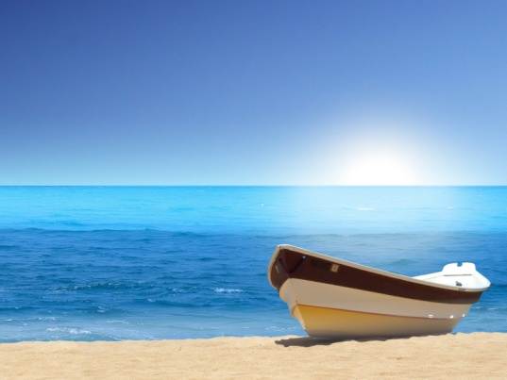
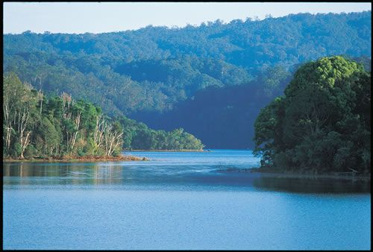
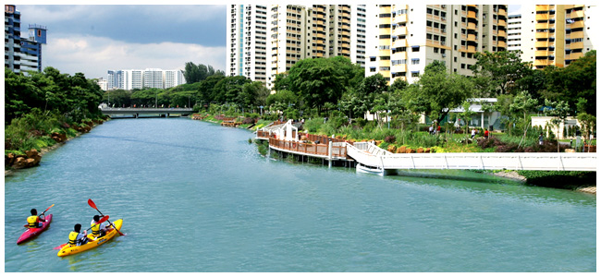
Where Does Water Come From?
Underground Water
Stillwater
Oceans
Lakes
Rivers
Notes:
*Presenter 1*
Before pictures pop up ask:
In Australia, where do we get water from?
After pictures pop up ask:
Are they drinkable? No….. How do we get them cleaned?

Slide 10
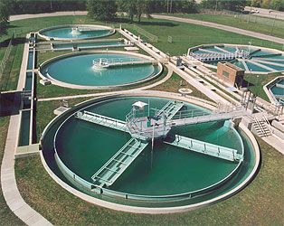
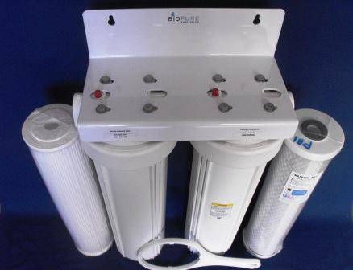
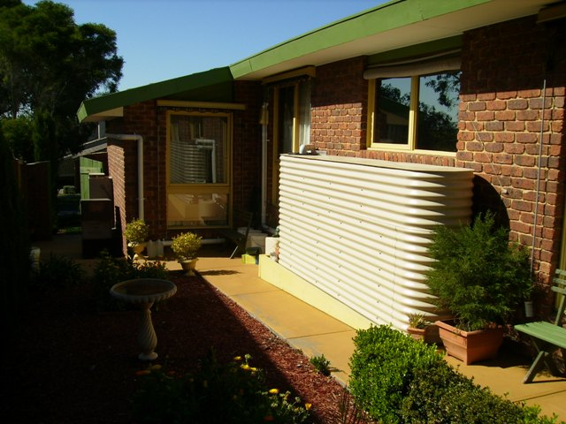
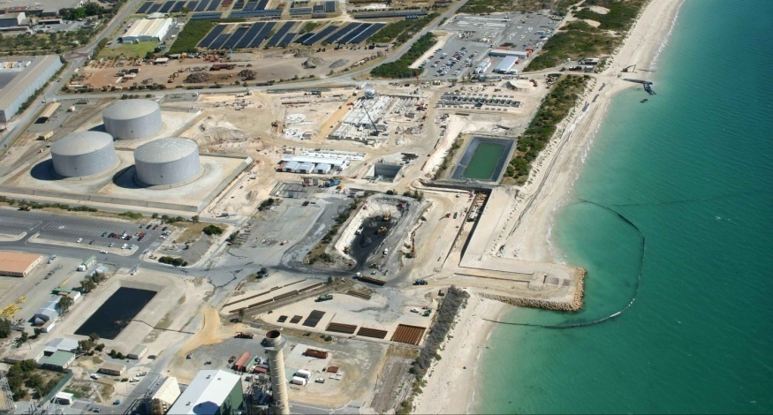
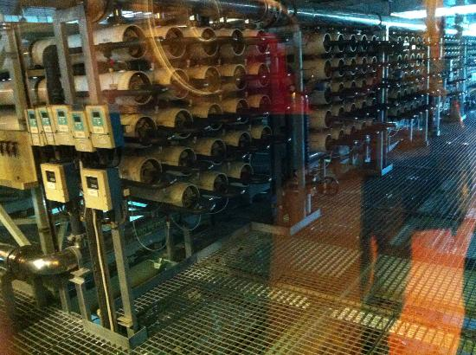
Water Filtration Methods
HOUSEHOLD WATER FILTER
RAINWATER TANK
Clarifiers
DESALINATION PLANT
REVERSE OSMOSIS
Notes:
*Presenter 1*
What sort of technologies are available to improve water quality?
From top left: in clockwise direction: 1 Clarifiers – used in large scale water treatment plants
2 Household water filter – can be found under kitchen sink
3 Rainwater tank – used to collect rain water
4 Reverse osmosis in factory – a process of removing solids from liquids
5 Desalination plant – used to remove salt from seawater
Are they applicable in developing countries? No….

Slide 11
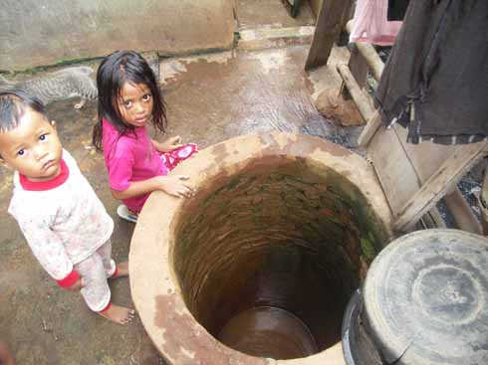
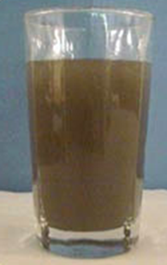
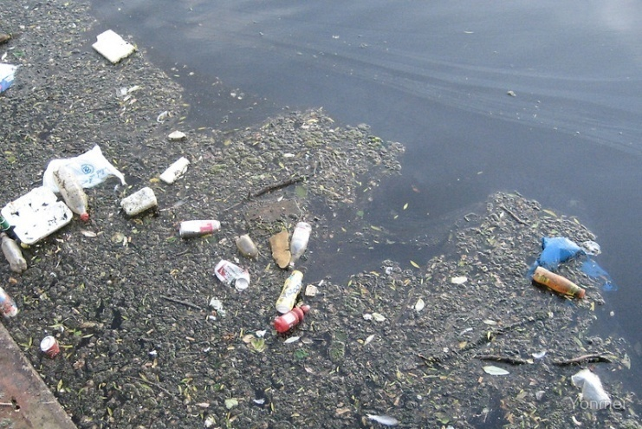
Access to Clean Water Around the World
780 million people around the world lack access to clean water
3-4 billion people live on less than $2/day
Notes:
*Presenter 2*
Breeze through this slide. This is just to give context
The world today has lots of challenges that need to be faced:
780 million people lack access to clean water – that’s 1 in every 9 people around the world. And its getting worse not better. (UNICEF 2012)
½ of world population have very low income
Picture, Jakarta, Indonesia.
Jakarta is Indonesia’s biggest city, with 20 million inhabitants (i.e. Australia’s Population in one city), and still water is of major concern.

Slide 12
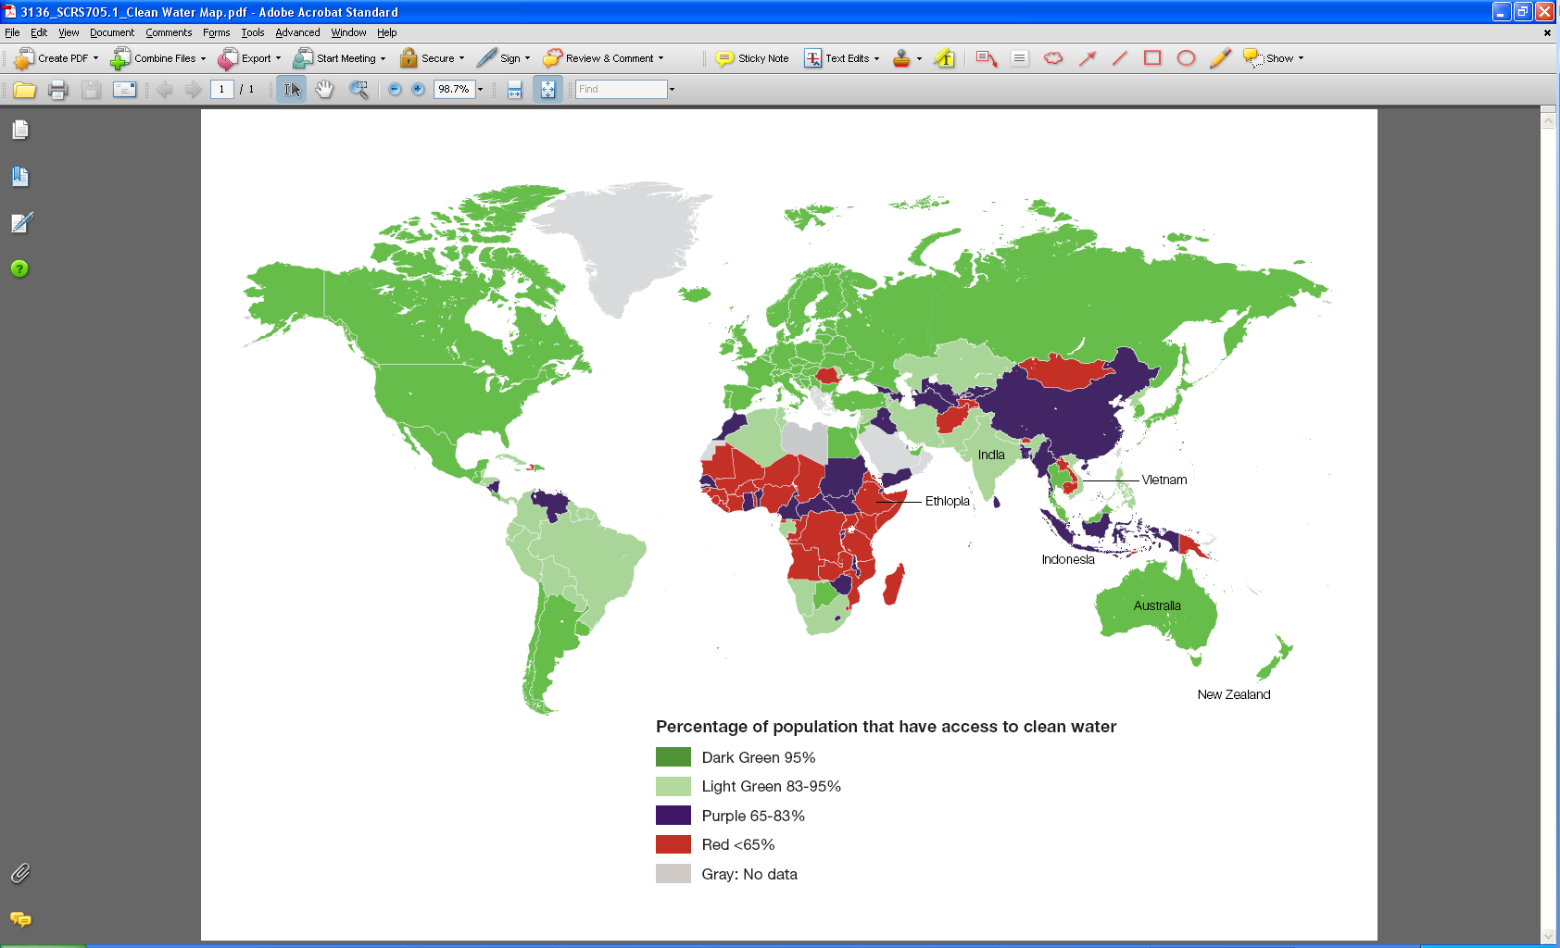
Access to Clean Water Around the World
Notes:
*Presenter 2*
Compared to the rest of the world, Australians have it really good when it comes to clean water.
As shown in dark green on the map, more than 95% of Australians have access to clean drinking water that flows from our taps.
There are many countries, particularly in Africa and Asia (as shown in red/purple on the map), where significant portion of the population do not have access to clean drinking water.

Slide 13
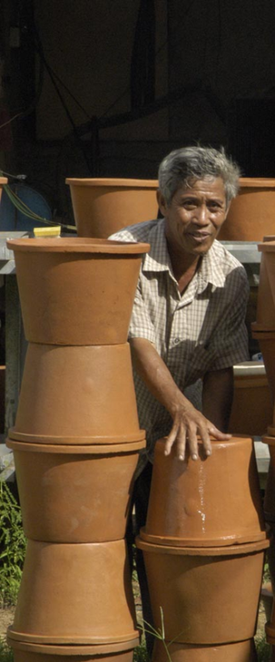
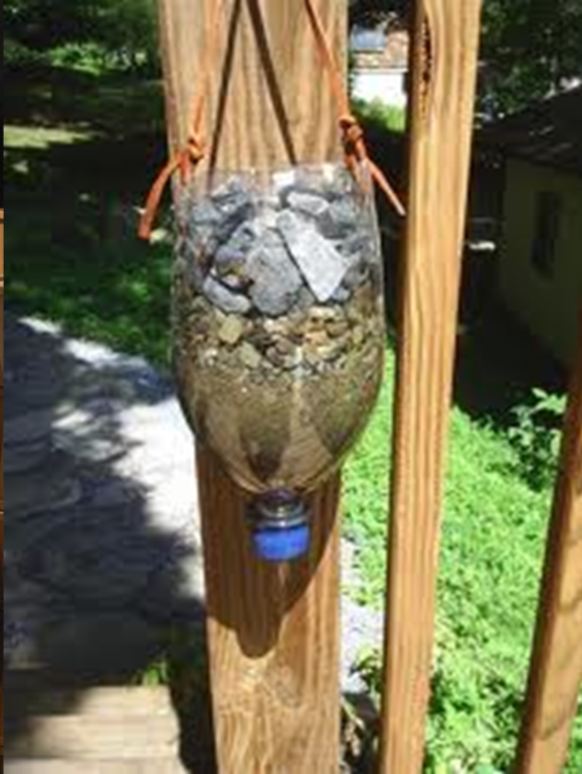
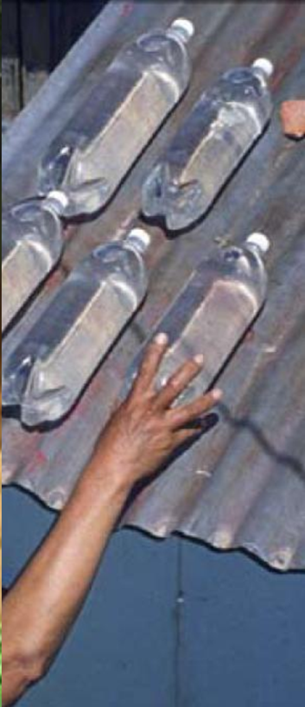
Alternative Water Filtration Methods
Notes:
*Presenter 1*
Explain the water filters
Left: Ceramic/clay pot filters. An inexpensive and effective type of water filter that rely on the small pores in the material to filter dirt and debris out of the water.
Middle: Sand filters. Using sand, gravel and recycled materials to separate the dirt in the water
Right: Solar water disinfection using plastic water bottles. Solar energy and UV radiation rid contaminated water of bacteria and viruses.

Slide 14
What is appropriate?
Cost
Physical
Environment
Available Materials & Electricity
Required Knowledge
Maintenance
People &
Culture

Slide 15
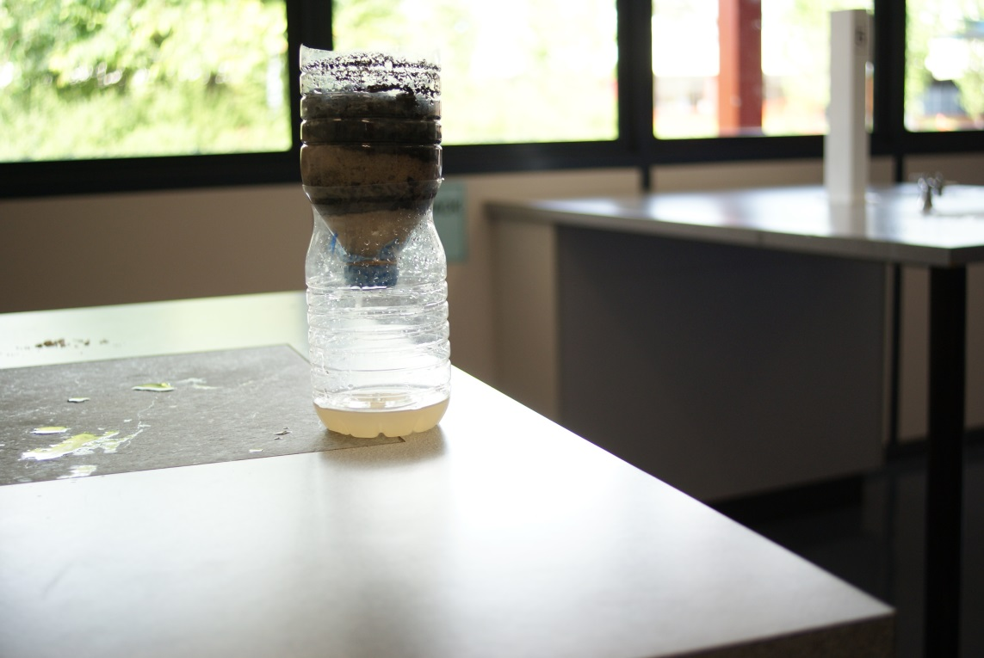
Activity
Build a working water filter!
Notes:
*Presenter 2*

Slide 16
Instructions
The aim: filter out the cleanest water!
Tasks | Minutes
1. Split into groups and go to a workstation | 2
2. Read information kit and plan your design | 10
3. Buy materials | 5
4. Build your water filter | 10
5. Test your water filter with dirty water | 5
Notes:
*Presenter 2*

Slide 17
Access to Clean Water Around the World
Notes:
Leave this slide on during activity.

Slide 18
Congratulations!
What worked well?
What didn’t work so well?
What can be improved?
Notes:
*Presenter 1*

Slide 19
The Real World
Activity | Real world
Different amount of money per group
Illegible instructions
Limited materials
Collaboration between countries
Inventive ideas
Different countries have different national budgets
Based on actual country’s illiteracy rate
Access to materials can be dependent on geographical location
Foreign aid: AusAid, United Nations, World Vision, WHO etc.
The lack of information, funds, or resources can often encourage creative and effective ideas
Notes:
*Presenter 1*
Ask the kids about each point – get them to think for themselves before clicking and revealing the answers in ‘Real World’.
Prompt them with things like:
“Did all groups have the same amount of money?”
“So how do you think having different money in each group translates to the real world?”
- Money given were based on the country’s GDP.
“Could you all read the instructions?”
“What do you think having illegible instructions means when Australia’s instructions are really clear and Ethiopia cannot understand theirs at all?’
Illegibility of instructions were based on the country’s literacy rate
“Isn’t interesting to see that some of the poorer countries had reasonable results?”
“How did your group cope with limited money and instructions?”
- Inventive ideas
“Did any of the more developed countries help the others?”
- Emphasize that developed countries have a social responsibility to help those in developing countries.

Slide 20
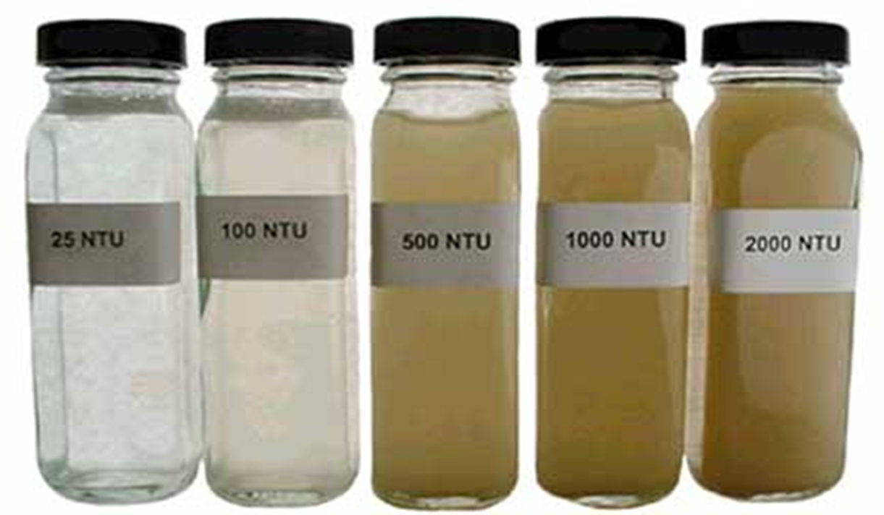
Turbidity
Notes:
*Presenter 1*
Turbidity
The cloudiness or haziness of a fluid caused by a large number of individual particles that are generally invisible to the naked eye, similar to smoke in air. The measurement of turbidity is a key test of water quality.
NTU - nephelometric turbidity units
World Health Organisation (WHO) – International body, does research into all things health
WHO says <5 NTU is required for drinking water
Even in developed countries we can’t treat water with filtration agents like chlorine until it is below 5 NTU. Chemicals don’t react properly.
According to the Australian Drinking Water Guidelines, water should be less than 5 NTU.
Get the groups to estimate the turbidity of their clean water.
Give out prizes for the cleanest water

Slide 21
Pop Quiz!
What is an engineer?
What are some factors that you need to consider when choosing an Appropriate Technology?
What challenges do developing countries face in the real world when creating water filters?
Notes:
*Presenter 2*

Slide 22
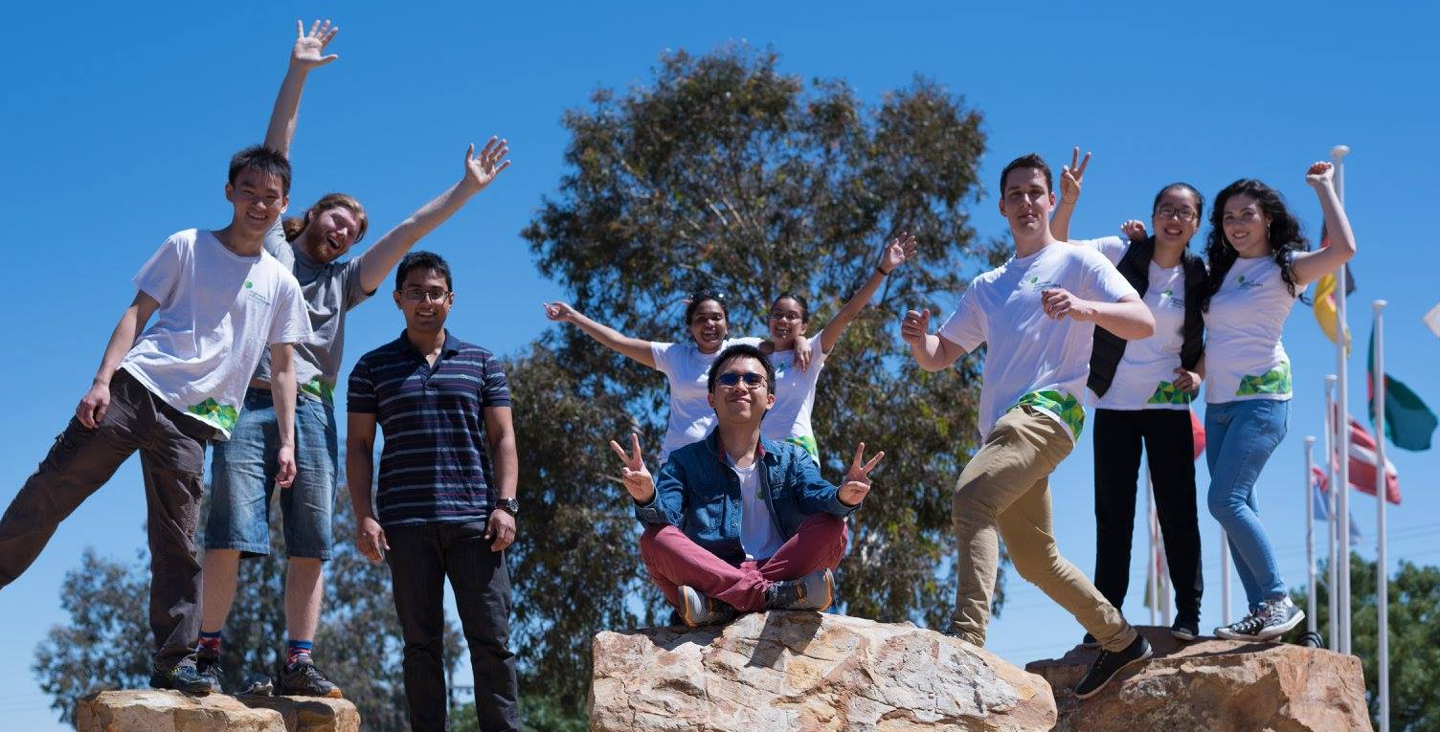
Like What You’ve Learned About Today?
Right now:
Stay informed. Think about what you want to fix in the world and how to do it
Spread the world about humanitarian engineering
Like us: facebook.com/ewbaustralia
Future:
Study at university or TAFE and volunteer
A job that makes a difference!
Notes:
*Presenter 2*

Slide 23
Questions?

